Slide 1


Lending Club Case Study
by
Remella Satya Ramana Kumar

Slide 2
Abstract
Lending club is the largest online loan marketplace, facilitating personal loans ,business loans, and financing of medical procedures.
Borrowers can easily access lower interest rate loans through a fast online interface.
The objective of analysis is to use the information about past loan applicants and find whether they are eligible for taking a loan or not.

Slide 3
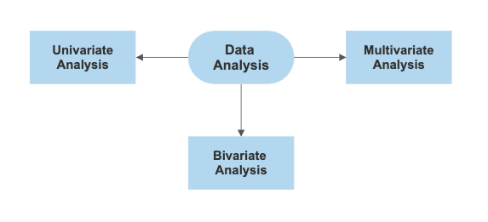
Solution methodology:
1. Data Understanding
2. Data Cleaning
3. Data Analysis
i. Univariate Analysis
ii. Segmented Univariate Analysis
iii. Bivariate Analysis
iv. Multiple Variate Analysis
4. Conclusion

Slide 4


Slide 5
Data Under Standing :
Data understanding involves accessing the data and exploring it using tables and graphics.
The main goal of data understanding is to gain general insights about the data that will potentially be helpful for the further steps in the data analysis process.
So we are having an Excel sheet which contains various columns of data such as Interest rate , Loan amount , Reason for Loan , Term , Installmant , etc.
We have to find the necessary columns that can be used to do the data analysis and we can eliminate the rest.

Slide 6


Slide 7
Data Cleaning :
Data cleaning is the process of fixing or removing incorrect, corrupted, incorrectly formatted, duplicate, or incomplete data within a dataset.
Data cleansing helps ensure that data is consistent so it can be analyzed accurately. Duplicate data.
The best data that we can use in order to do the data analysis for an online money lending company are the columns that are related to the social and economic categories of a person.
So we can keep that data and we can let go of the other data that is not related to the current requirement.

Slide 8
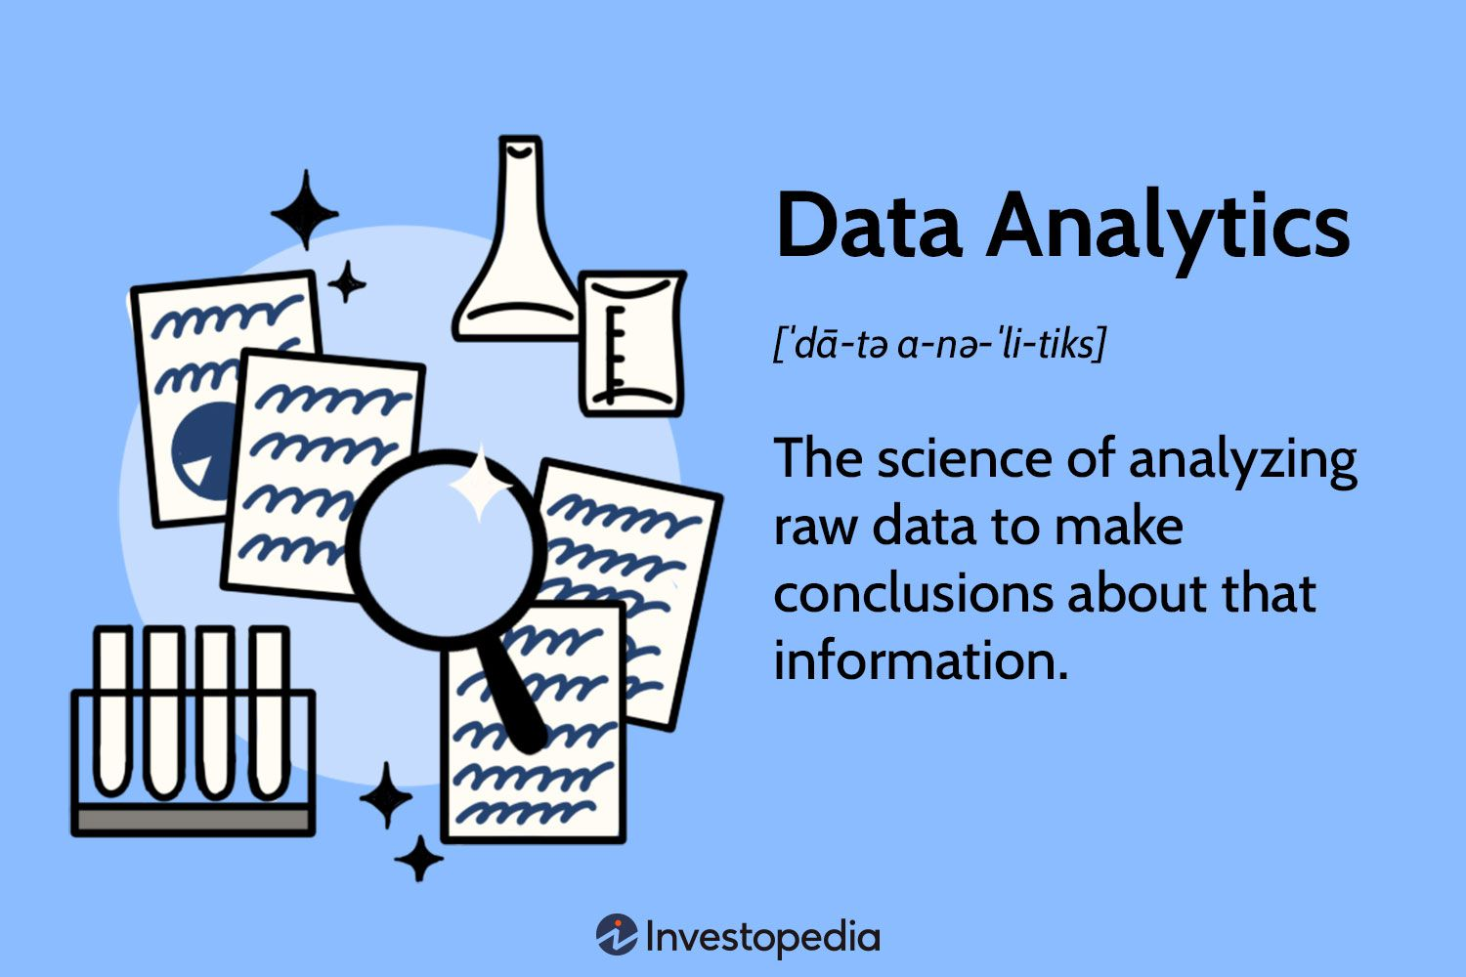

Slide 9
Univariate analysis :
Univariate analysis explores each variable in a data set, separately. It looks at the range of values, as well as the central tendency of the values.
The columns are Interest rate, Loan amount, DTI, Funded amount, Funded amount inv.
The plot used for this is a box plot.

Slide 10
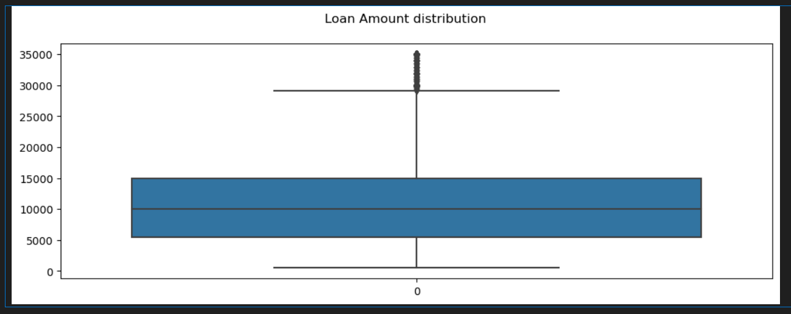
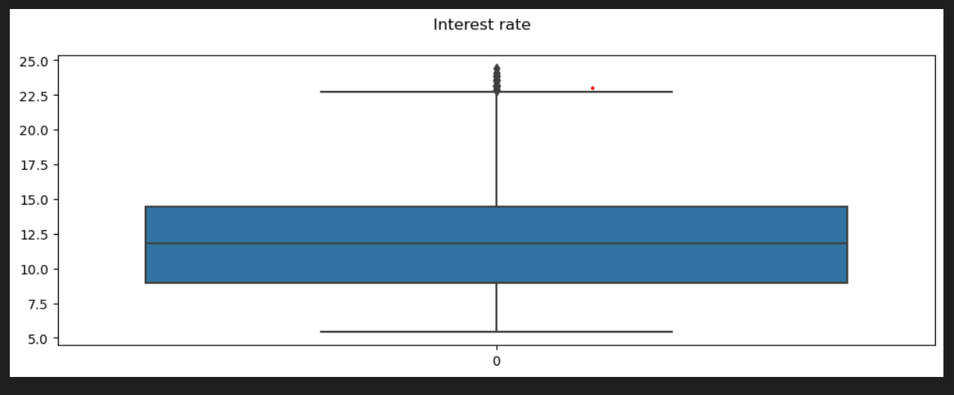
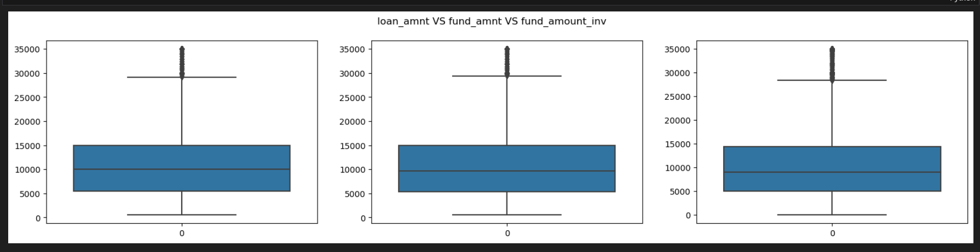
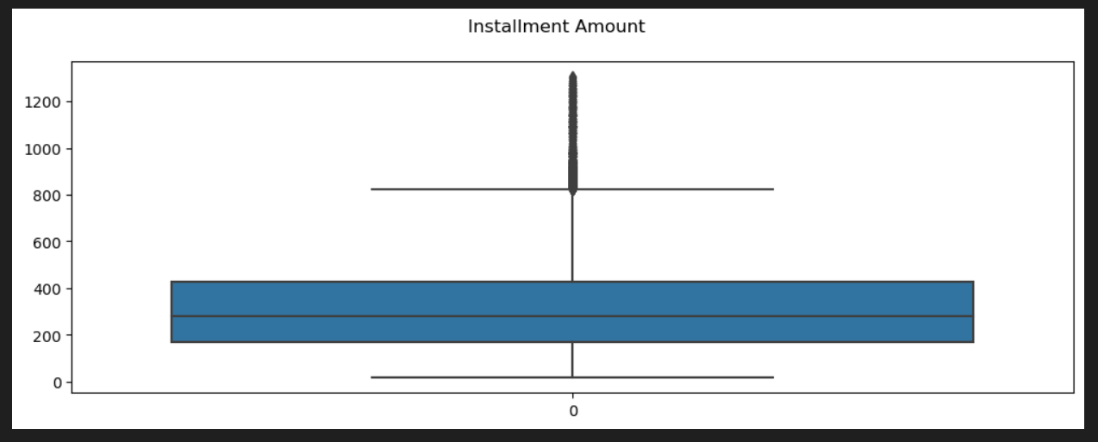
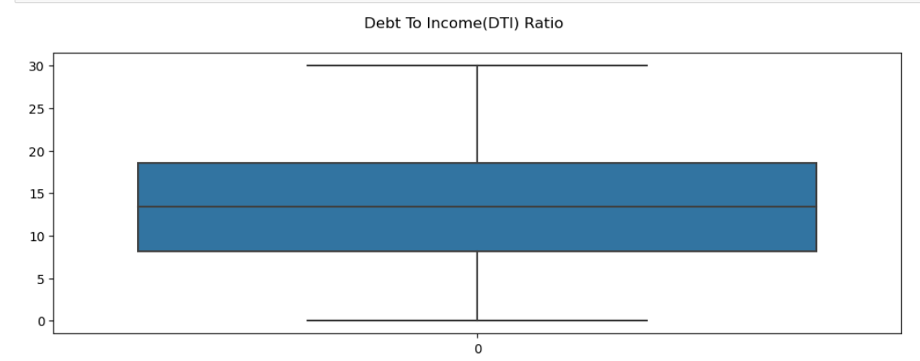
Box plot of 5 different columns :

Slide 11
Observation for Unvariate Analysis:
The common Loan amount taken varies between 5000$ to 15000$, the minimum amount taken is 500$ and the maximum amount is 35000$.
The DTI ratio varies between 5 to 15 mostly and the maximum is 30 and that is a very good sign considering the living expenses in America.
The Interest rate is between 8% to 15% commonly and the maximum 25%.
The Installment Amount is between 200$ to 400$ and there are some outliers in this because of the less tenure time and more loan amount category.
The loan amount, The total amount committed to that loan at that point in time, The total amount committed by investors for that loan at that point in time are almost thee same.

Slide 12
Segmented univariate analysis :
Segmented Univariate analysis can be used to find summary of a single data variable in form of segments.
In this category we can give analyse the Tenure, loans issued every year, home ownership, Loan Status.

Slide 13
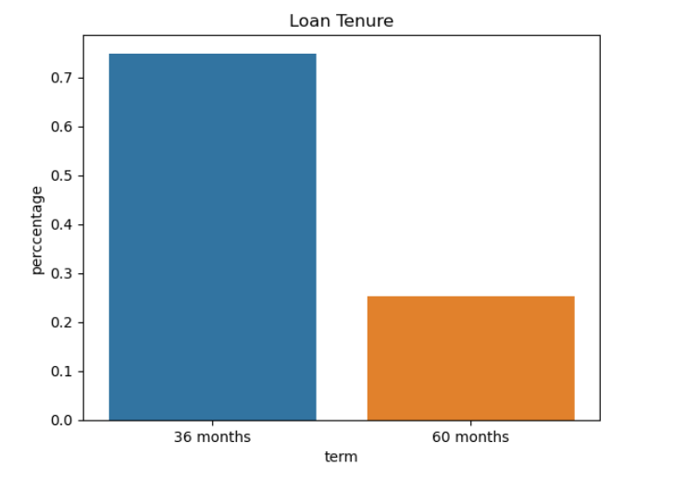
The loan Tenure can be 36 and 60 months.

Slide 14
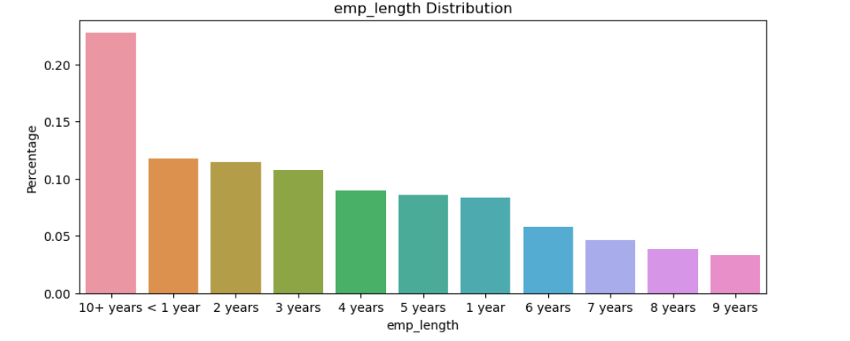
The employee experience varying from less than 1 year to 10+ years.

Slide 15
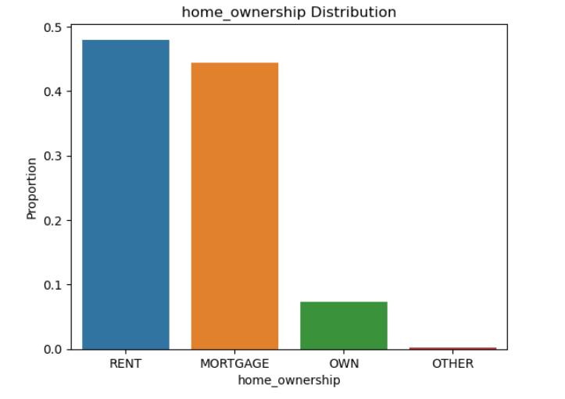
More people are living in rented house and mortgage house than in own house and that is a bad sign.

Slide 16
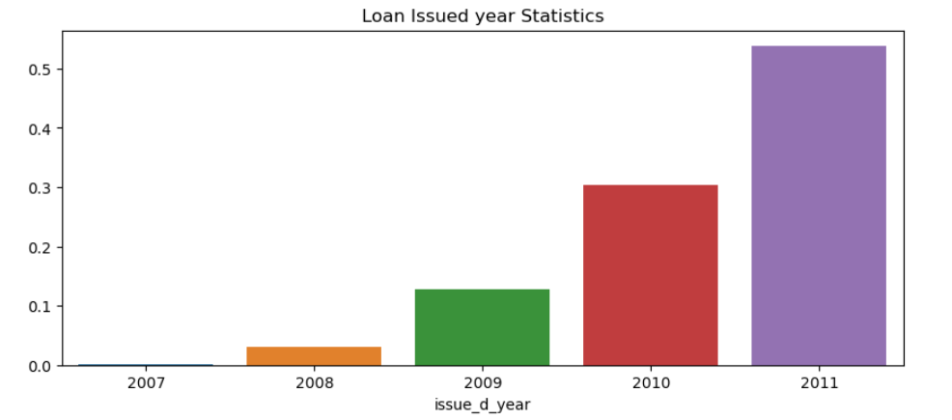
The plot depicts that the number of loans granted by the organisation are increasing every year and that is a good sign.

Slide 17
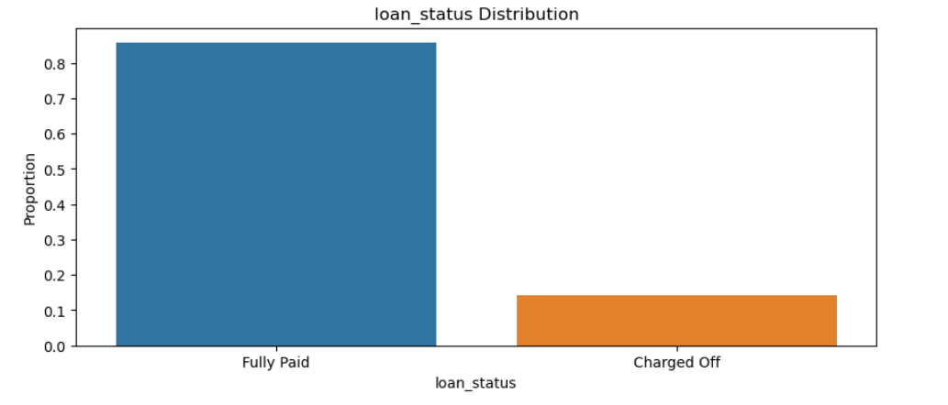
The plot depicts that the loan status is fully paid for more people that is good sign.

Slide 18
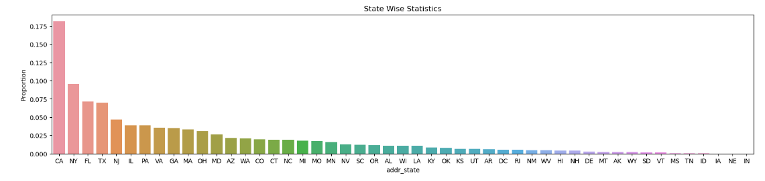
The above plot depicts that states like California , New York , Florida , Texas have highest number of loan seekers and those states are also the most populous states in the country.

Slide 19
Bivariate Analysis :
Bivariate analysis is stated to be an analysis of any concurrent relation between two variables or attributes.
This study explores the relationship of two variables as well as the depth of this relationship to figure out if there are any discrepancies between two variables and any causes of this difference.
We can create patterns for every columns in the data using bivariate analysis and the most useful pattern that can be a good business are below.

Slide 20
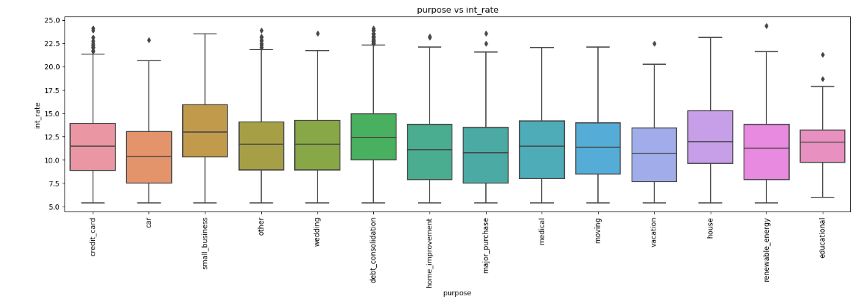
The above plots depict that all interest rates are almost similar, but small business and houses are a having a slight advantage over the rest.

Slide 21
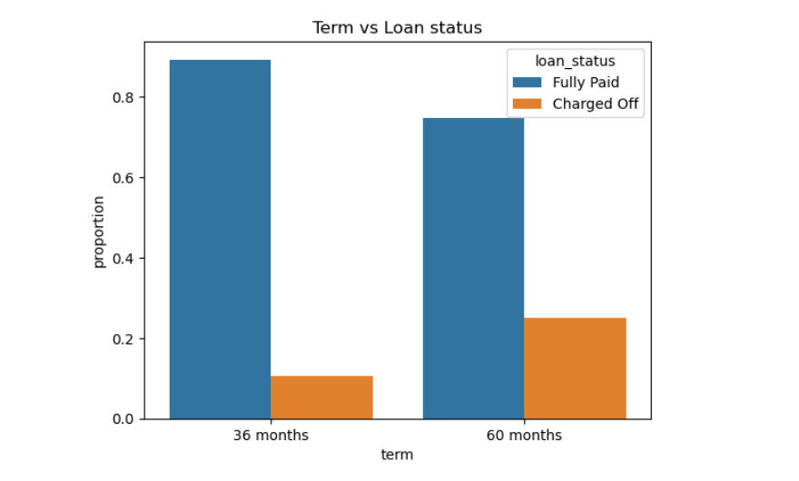
The above plot depicts that when 36 months tenure is taken mostly people tend to pay it on time.
The people who take 60 months tenure are being charged off 30 percent of the time according to the plot.

Slide 22
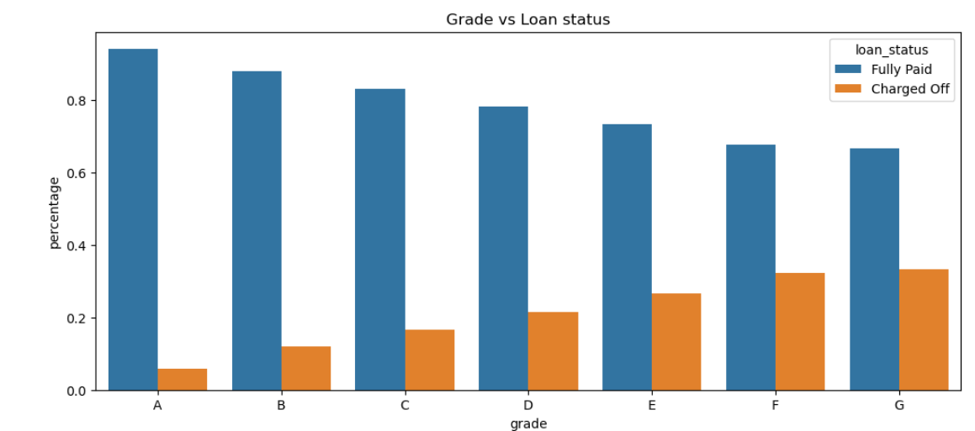
The above plot depicts higher the grade, higher the number of people being charged off and that is not a good sign.

Slide 23
Multi variate Analysis :
Multivariate analysis involves evaluating multiple variables greater than two variables to find the patterns between data or any correlation exists between them.

Slide 24
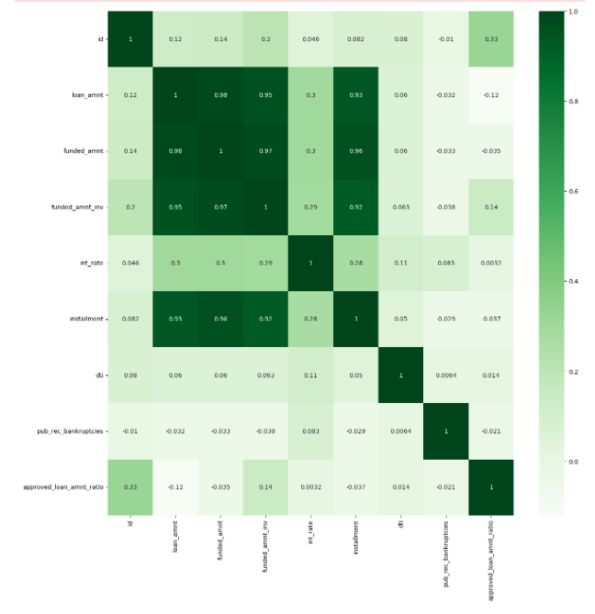

Slide 25
Observation of multivariate Analysis :
The data is positively correlated mostly that is a good sign.
Public records bankruptcies and Loan amount are negatively correlated.

Slide 26


Slide 27
Conclusions :
Lending club should reduce the high interest loans for 60 months tenure so that more people take the 60 months tenure and ultimately it generates more revenue as there is a time period difference.
Grades are good indication for detecting defaulters. Lending club should examine more information from borrowers before issuing loans to Low grade (G to A).
More loans and less interest rate should be provided to small business category because that is when more revenue will be generated and GDP of a country goes up eventually increasing the currency value and the stock prices of the company and more returns come back to you.
More loans and less interest rate should be provided to housing loans because housing loans can vary from 1 to 30 years and if less interest rate is provided eventually on a long term the company can make money.

